Slide 1
UG Tech Approach

Slide 2

Contents
Business Requirements
Software Options
Refilling Canisters

Slide 3
Business Assumptions
We will only have a KOKO Agent (we will not have other agents for the foreseeable future)
Canister swaps for full canisters only
No need for a KOKOpoint, hence, no KOKOpoints
Rig for refilling canisters in the “back office” (manual + pump driven)
Business can run all day offline and data will be eventually available on the system (assume offline first)

Slide 4
Business Requirements
We want to be able to know who the customers are
We want to be able to know how much fuel each customer has purchased
We want to be able to know if they have substituted their existing fuel source for KOKO

Slide 5
What we are not trying to do
Expand to UG - this is not the scope of the UG micro pilot. We don’t need all of the awesome tech that we have built and all of the operational teams on the ground in KLA
Showcase our technology working at scale - We have a pretty good example and showcase of this in Nairobi, it is not worth the effort to do it.
Achieve operational efficiencies - we know that by largely deploying the NBO model in KLA we can get a lot of efficiencies. In any case the largest cost of the pilot will be the fuel subsidy cost.

Slide 6
Contents
Business Requirements
Software Options
Refilling Canisters

Slide 7
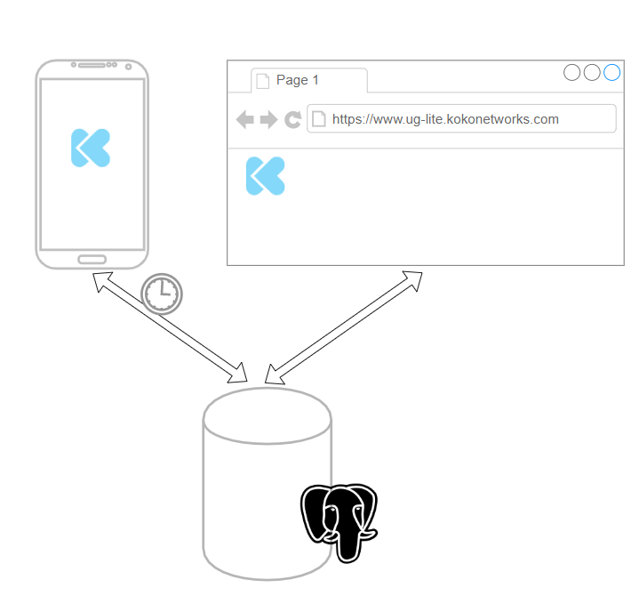

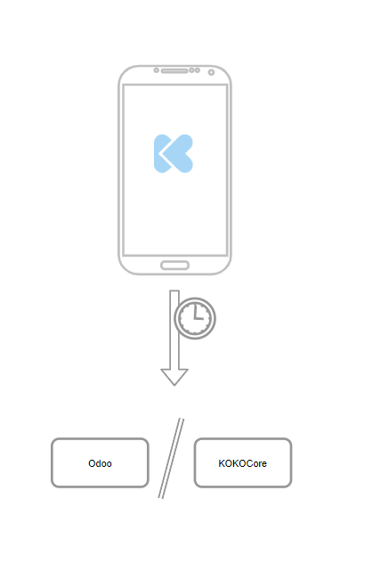
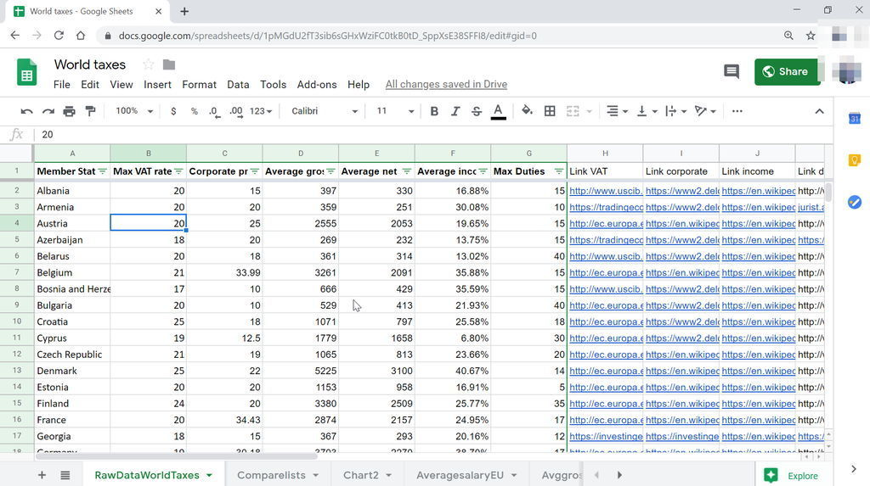
Software Options
A
B
C
NOT DOING
Google Form to record transactions and sales
Google sheets backend to store the info and perform analysis
Front end android app to record transactions and sales
Simple dedicated backend data store
Front end android app to record transactions and sales
Odoo // KOKO core as backend data store
Notes:
Google Forms don’t work offline
No requirement to deploy to Odoo or KOKO core

Slide 8
Requirements for option B
Requirements Doc ⇒ https://docs.google.com/document/d/1TYvNbu-RFfrU_kiKSkmNIdTtgxXB79akdUUunkjo674/edit
User journey flow ⇒ https://drive.google.com/open?id=1-qy1zdD7-i0PvBvbi0QX8Jz_nsuHW5lu
Mocks for the UI ⇒
Estimates ⇒

Slide 9
Contents
Business Requirements
Software Options
Refilling Canisters

Slide 10
Refilling without a KP (Bottling)
Store bulk fuel in an IBC
Have a pump based rig that can refill a canister
Have a gravity fed system that can work as a redundant channel for refilling
Main issue is how to ensure high precision of fuel sold. (This isn’t a requirement?)
Bulk storage in IBC
Gravity Based redundant refill system
Pump based canister refill system

Slide 11
Refilling with a KP (Bottling)
Store bulk fuel in an IBC
Use a KP to refill canisters
Have a gravity fed system that can work as a redundant channel for refilling
Main issue is how to ensure uptime of the KP, we would need a backup channel anyway. Not worth the effort to bring it along and maintain it.
Bulk storage in IBC
Gravity Based redundant refill system
NOT DOING
Canister refills via KP

Slide 12
Tim Muchai

